Slide 1
Material Properties and ET
Meeting June 4, 2024

Slide 2
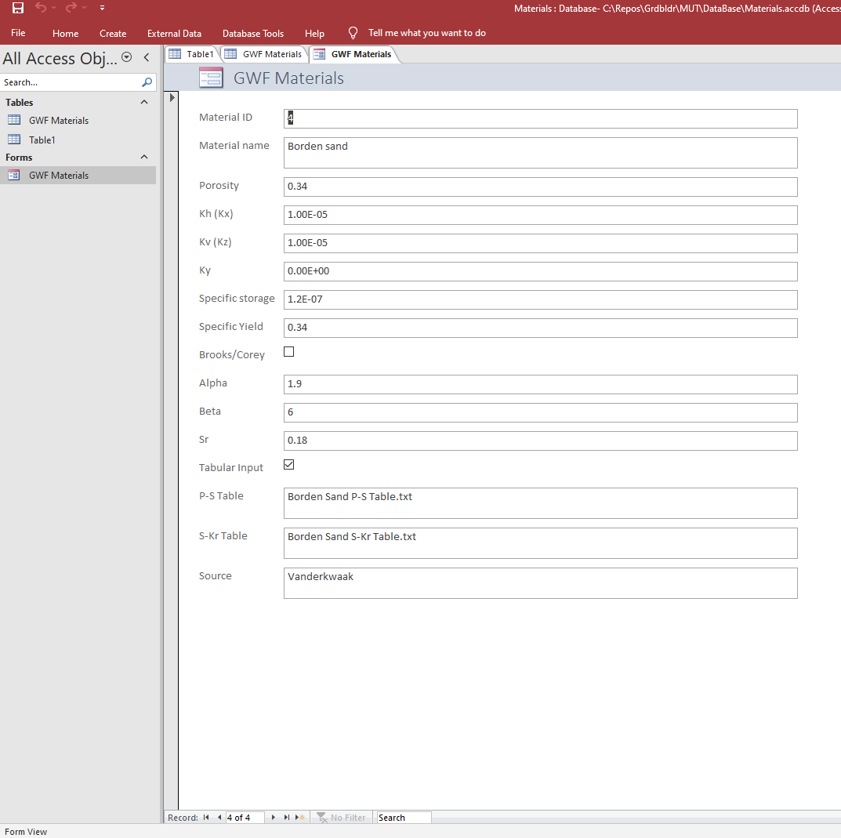
GWF Material properties
We assume horizontal isotropy (Kx=Ky) and use Kh and Kv for the horizontal and vertical hydraulic conductivity. For now, Ky is reserved as a placeholder.

Slide 3
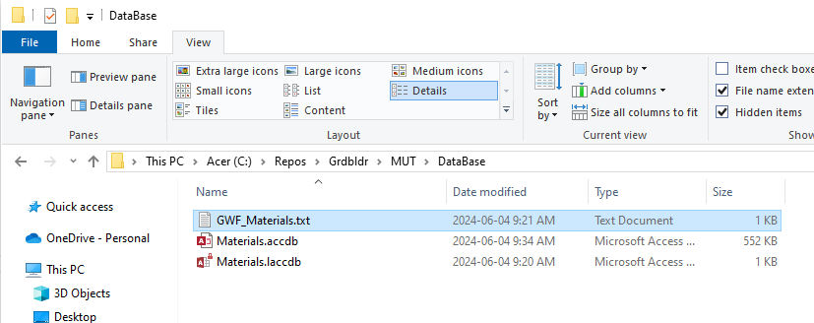
I added a Database directory in the repository

Slide 4
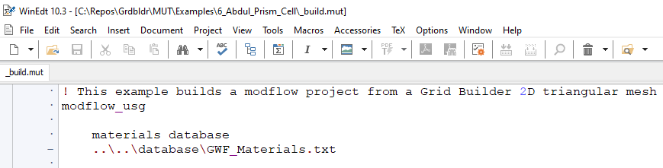
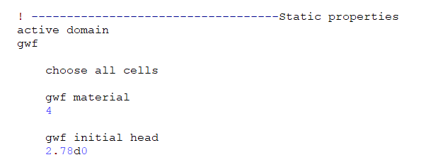
If you want to use the database, you need to first set the path then choose the cells and assign the properties by material ID number

Slide 5
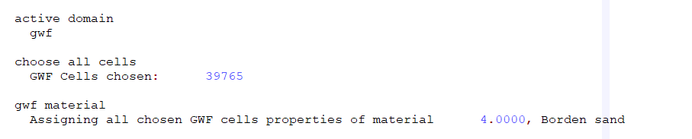
The MUT pre-processor .eco file shows the name of the material matching the material ID

Slide 6
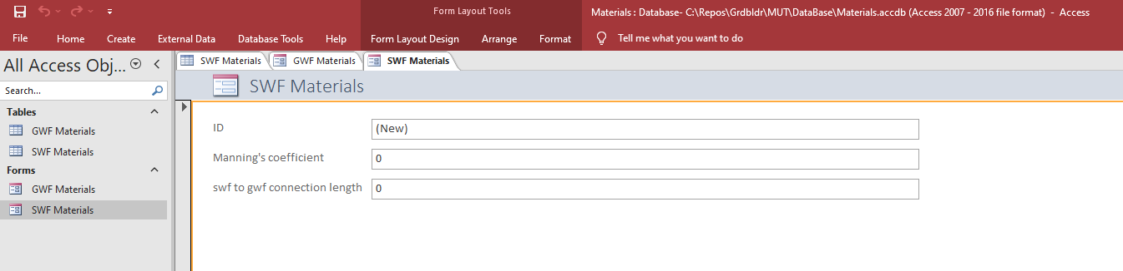
SWF Material properties
We consider depth smoothing to be a solver (i.e. general) parameter
I need a list of SWF parameters

Slide 7
I need your slides for ET parameters etc
For now, use ET parameters from Panday verification example

Slide 8
Next Steps
Implement a 2D (template) face/neighbour/element scheme in fortran instead of using Tecplot
Current Tecplot approach doesn’t work for CLN or Quadtree
Implement kriging and rasters in pre-processor for surface elevations
Implement outer boundary import to use as mesh cookie cutter in pre-processor
Make sure all examples can be built in pre-processor
User’s Guide
ET inputs
SMS inputs
User-defined zones

